Slide 1
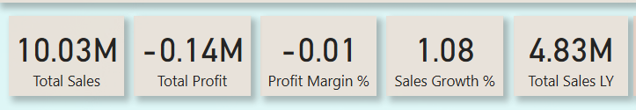
Overall KPI Summary: This KPI panel shows the overall business performance: Total Sales: 10.03M Total Profit: -0.14M (indicating a loss) Profit Margin %: -0.01, which shows profitability is negative Sales Growth %: 1.08 – slight growth compared to last year Total Sales Last Year: 4.83M Although sales have increased since last year, the business is currently facing a loss, which needs strategic cost control and margin improvement.

Slide 2
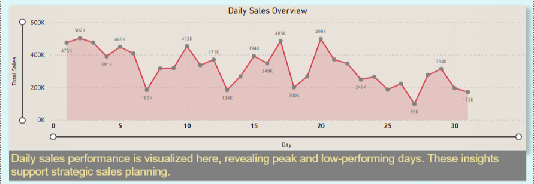
Daily Sales Overview: This line chart shows the fluctuation of daily sales throughout the month: Peaks were observed around Day 2 (502K), Day 11 (453K), Day 18 (485K), and Day 20 (499K) Low-performing days include Day 6 (185K), Day 14 (184K), and Day 26 (99K) These patterns help understand customer behavior and optimize promotional strategies on low-performing days.

Slide 3
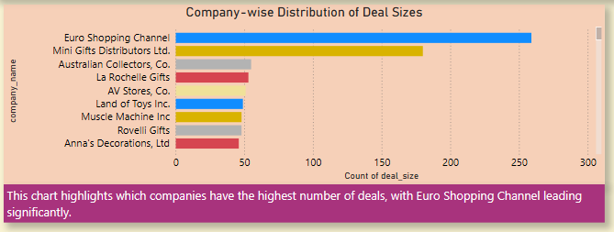
Company-wise Distribution of Deal Sizes: This bar chart shows which companies have the highest number of deals.
Euro Shopping Channel is leading significantly with the highest number of deals, followed by Mini Gifts Distributors Ltd.
The remaining companies have comparatively fewer deal counts. This insight helps identify top-performing clients in terms of deal volume.

Slide 4
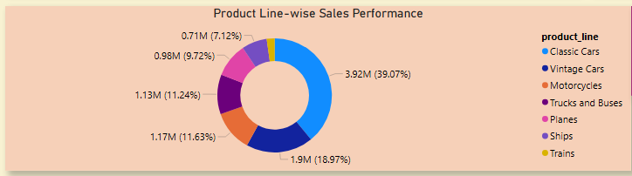
Product Line-wise Sales Performance: This donut chart shows sales performance by product line: Classic Cars have the highest sales share (39.07%) Followed by Vintage Cars (18.97%), Trucks and Buses (11.63%), and Motorcycles (11.24%) Trains contribute the least This helps identify the most and least profitable product lines for better resource allocation and marketing efforts.

